Slide 1
Stonehenge
By Zoárd szabó 9ny

Slide 2
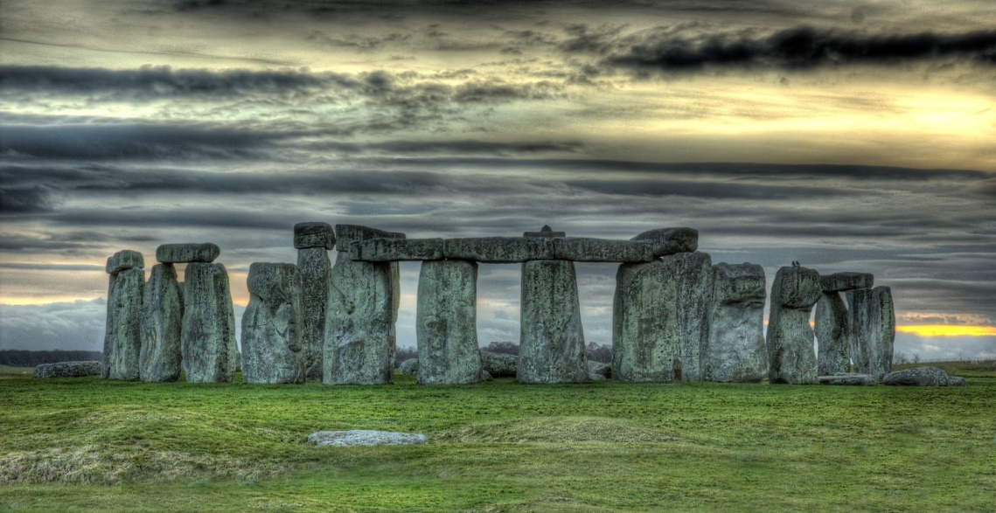
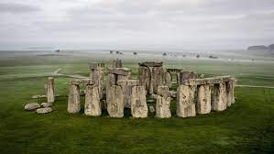
Stonehenge parameters
Stonehenge was assembled about 3000 before Christ.
It is located in England.
All the stones are about four meters tall and about two meters wide.

Slide 3
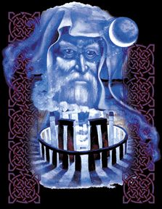
Theories and folklore
There is a myth that during the fifth century there was a battle in which many British died fighting the Saxons. The dead were buried in a place called Salisbury plain, which is the same as the modern Stonehenge.
According to another tale, the devil was the architect of Stonehenge. The story tells that an elderly Irish woman originally owned the stones used to build the Stonehenge.

Slide 4
Conclusion
There is little to no evidence revealing the construction techniques used by the Stonehenge builders. Over the years, various authors have suggested that supernatural or anachronistic methods were used. The most common theories of how people moved the big rocks is that they created a track of logs and they rolled them on them.
In my opinion there is nothing interesting about this, but this is the easiest to talk about.

Slide 5
Thanks for the attention

